Slide 1




IBM
Data Resilience
IBM Flashsystems
IBM Tape
Steve Kenniston
Global Market Development Executive steve.kenniston@ibm.com
@skenniston
Spectrum Protect Professionals
Notes:
Data protection has continued to morph over the last 20+ years. Today we are seeing a new evolution as to what it means to ensure data is safe and protected.
Hi, my name is Steve Kenniston and I am a Global Market Development Executive at IBM for the Spectrum Storage portfolio.
It used to be that when businesses though about data protection, they thought about backup and recovery. Today’s data protection, is now all about ensuring that your business is resilient, and since data is the lifeblood of business, is your data resilient?
Let’s explore this evolution of data resilience.

Slide 2

Agenda
Data Resilience – Defined
Determining Data Resilience
Data Resilience Classification
Creating Data Resilience
Architecting
Moving – Software
Protecting – Hardware
Recourses
Notes:
In this presentation we will:
Define data resilience
How to architect for data resilience
Classifying your data
Creating data resilience
From architecture to
Moving data in the environment – or the software that would do that to
Where the data lands for full protection and why
We will also share some resources on the products we mention in this presentation that can help build a data resilient environment

Slide 3

Data
da·ta
/ˈdadə,ˈdādə/
noun
facts and statistics collected together for reference or analysis.
Resilience:
re·sil·ience
/rəˈzilyəns/
noun
the capacity to recover quickly from difficulties; toughness.
Data resilience:
da·ta re·sil·ience
/ˈdadə,ˈdādə/ /rəˈzilyəns/
noun
the capability to recover data quickly from any data destructive event
Notes:
For the most part, I believe that we all understand what “data” is, and have come to understand that it has become the lifeblood of business. It drives what we do, how we do it and our competitive edge.
[BUILD]
Resilience on the other hand, while the term does have a specific definition, that definition, I have found throughout building this presentation, can take multiple paths. Resilience means having the capacity to quickly recover from difficulties.
[BUILD]
It stands to reason that “Data Resilience” is recovering data from any difficulty businesses may face when it comes to a data impact or data loss such as a corrupt file, natural disaster or cyber-attack.
Now much like every conversation in IT, when it comes to infrastructure and technology, you need to apply the “It Depends” rule. This is especially true when trying to identify “how” resilient to architect the business. Resilience, in the case of IT, is also about flexibility as well as toughness. It’s important to keep in mind, that even the most resilient data center may not meet the needs of the business because data is inaccessible and doesn’t foster a competitive business model. Businesses today need to design for resilience, but also make sure the business can get done what it needs to in the process.
These conversations often start to circle around budget and the different technology capabilities that can provide the right kind of resilience.
Based on this, let’s review practitioner best practices and technology capabilities that enables businesses to intelligently and thoughtfully understand how they can make the right decision to protect the business for the right cost.

Slide 4
Data Resilience Market
USD
$27.63
Billion
Attractive Market Opportunities
The data resiliency solutions market is estimated to be USD 11.69 billion in 2018 and is expected to reach USD 27.63 billion by 2023, at a CAGR of 18.8% from 2018 to 2023.
By vertical, the BFSI (banking, financial services, insurance) segment is expected to account for the largest share of 25.9% of the data resilience solutions market in 2018.
There is an increasing adoption of cloud-based data backup and recovery solutions for data security and privacy as enterprise process large volumes of data.
CAGR
18.8%
USD
$11.69
Billion
2018
2023
Data resiliency solutions include data backup and recovery, archiving, e-discovery, and disaster recovery. Resiliency can be applied to multiple applications, IT components, data centers, and cloud environments. Recovery Point Objective (RPO) and Recovery Time Objective (RTO) are two significant parameters that help enterprises choose an optimal data backup and recovery plan.
Source: 2018 Markets and Markets – Data Resiliency Market report
Notes:
Before anyone starts to think that “Data Resilience” is just another term vendors are using steer away from a crowded back space, the reality is, this is a market that is tracked and measured. This Markets and Markets report on Data Resilience shows that businesses are paying close attention to the resilience of their data. While it is true, the data resilience market does comprise itself of backup and recovery it also takes into account, archiving, e-discover, disaster recovery, and data reuse.
Data Resilience has been tracked by BFSI (banking, financial, services and insurance) companies for a long time and they understand this space, and hence, tend to have good data resilience practices in place.

Slide 5

Architecting your data resilience strategy
Data classification
Determine data value by relevance
Fist stop in the data lifecycle
Where does data land on creation?
Design for recovery
Recover more data quickly
Practice, practice, practice
An untested plan isn’t a plan
Notes:
Data resilience best practices start at the architecture level. Here are four simple things to keep in mind when building out a data resilient environment.
Ensure to classify the data in the environment by data value or relevance
Think about the first-place data lands in your environment when created or copied from another location. The assumption is that data is needed and needs to be active, so ensuring that the initial storage where the data lands is resilient is important.
Next, don’t architect for “backup” but architect for quick recovery. This may mean that having environments separated out by important applications or grouping specific data sets together and deciding which technology can provide the best RTO and using that technology for these data sets can be the difference between getting your business up and running quickly or not at all.
Then, no matter what plan is in place – practice, practice, practice that plan to make sure the SLAs of the business can be met. If they can’t, go back to the beginning and start again until there is confidence that in the event of data loss, the business can get back up and running meeting the SLAs of the business.

Slide 6

Data Silos Classify your data
Define data categories & criteria
Critical
Necessary
Important
Identify how data should be protected
Create a data resilience workflow
Understand your data’s lifecycle
Monitor & maintain
Notes:
We said on the last slide that classifying data in the environment was a critical step and should be the first step taken to help build out a data resilient environment.
This starts with identifying which data is most critical to the business and which applications create this data. Then choosing how that data should be first recovered and its RTO, and then how it is protected, how long does it need to be kept and how it should be stored to be safe.
Once this is done, create a workflow that makes sure that any and all data in the system or new data in the system follows the proper life cycle and meets the businesses SLAs.
Think about utilizing technologies that have the capabilities to move data based on data type and move it to a class of storage based on its data type. IBM Spectrum Protect has this capability for example.
Then monitor and maintain this system and as we said, practice and adjust as needed.

Slide 7

Practitioner Best Practices
Isolation
Logical and physical separation
Immutability
Ease of corruption or destruction
Things to think about when architecting for data resilience
Performance
Speed to meet RTO/RPO in different scenarios
Ease of reuse
Instant access and fast recovery
Notes:
IBM delivers four key capabilities of data resilience across block, file, object, tape, software-defined storage, as well as the cloud. These should be key factors practitioners consider when implementing a data resilient infrastructure.
The first is, Isolation which is the degree of separation of a backup or snapshot from the rest of the network. Isolation can be achieved though logical means utilizing capabilities such as IBM’s Safeguarded Copy or IBM Cloud Object Storage (COS). Isolation can also be achieved through a physical air gap with IBM Tape and the Spectrum Protect family.
Next is Immutability, or tamper-proof storage that prevents any attacker, external or internal, from changing or deleting data. IBM offers multiple WORM (Write Once, Read Many) storage solutions such as, again, our DS8000 Safeguarded Copy, WORM Tape, Spectrum Scale Immutable file sets, IBM COS retention vaults, and the Spectrum Protect family for data retention.
Performance is also an important capability of the data resilience framework. How fast can your organization recover from data corruption, data loss, a natural disaster or a cyber-attack? While tape excels at isolation and immutability of your backup data, it can take several hours or even days for recovery. For those companies that need to recover in minutes instead of hours, IBM offers high performing recovery options with solutions in the Spectrum Protect family.
Ease of reuse or the ease of access to data that lives in the back up is important for testing recovery procedures, validating backups, and restoring data into an isolated environment to find a valid recovery point in the event of a ransomware incident. Spectrum Protect Plus and Spectrum CDM provide instant restore capabilities, into fenced environments, to get your organization back on its feet quickly and securely.

Slide 8

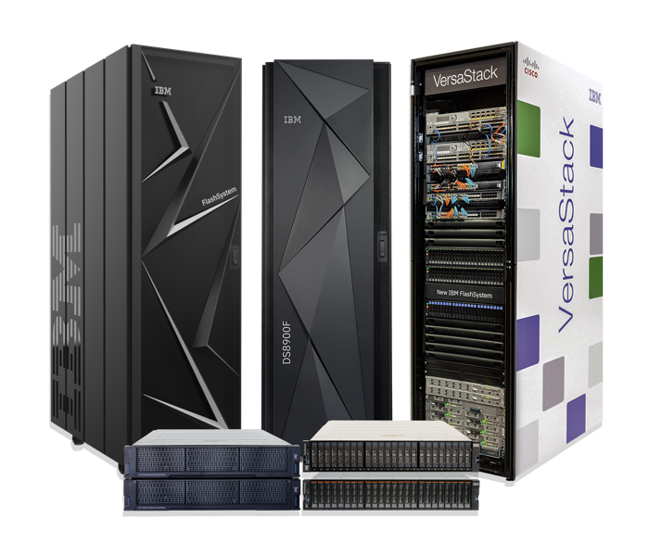
Is your primary storage resilient?
Each Flash Core Module (FCM) is a Self-Encrypting Drive (SED)
All encryption is FIPS 140-2 Certified
Systems have cryptographic erasure
Safeguarded copy
IBM Flashsystems
Notes:
Specific to IBM FlashSystems, we have a number of built-in security features. Theses start with encryption and Cryptography Erasure.
IBM’s FlashSystems all have FlashCore Modules, which you may hear referred to as FCMs that each have self-encrypting drives or SEDs that have media encryption keys for each drive.
Each drives security encryption is FIPS 140-2 certified.
And when it is time to securely erase the drive, the MEK (or the media encryption key) and the wrapped key structure where the MEK is stored, are both overwritten to ensure that the encrypted data on the drive cannot be decrypted providing full protection.

Slide 9






Data Resilience Tools
1
2
3
4
5
Encryption
FlashCore Modules with no performance impact
Software for consistent approach across IBM and non-IBM storage
Data in flight
Snapshots
System snaps / snap backups
Application-aware
Fenced off environment
Environment-integrated
Air Gap
“Logical” air gap;
Data stored remotely in immutable storage
“Cloud air gap;
Data stored remotely in AWS
Data stored on tape
Orchestration & Automation
Orchestration of disaster testing and failover processes across heterogeneous systems for reliable, speedy, and error-free recovery
Monitor
Malware, ransomware pattern detection
AI-based pattern anomaly detection
Notes:
IBM Storage and Data Resilience solutions deliver a comprehensive layered approach to data resilience.
Between encryption with IBM’s FlashCore modules and encryption with data in flight, even to the cloud, data is always protected at rest or in flight.
When data needs to be isolated from the network such that it can’t be attacked, taking advantage of an air gap is the best way. Data stored on tape is really the truest form of air gap and can provide the highest level of security. However, it can also be the slowest to recover from. The next form of air gap is immutable storage. Solutions such as the DS8000 and IBM Cloud Object Storage can store tamper proof copies of the data and can be recovered much faster than tape-based recovery. Finally, moving data to the cloud and off of the local network can provide you a way to logically air gap your data off your network as well.
The next thing to consider is having the ability to recover from snapshots. While snapshots are not the guaranteed way of ensuring a fully cyber resilient environment, snapshots can provide significant time savings for recovering an environment. Also,if utilizing a snapshot solution such as Spectrum CDM, that has a catalog of all the snaps taken, CDM can perform a very fast, iterative process for trying to find data quickly to recover from.
And finally, having a solution that can help monitor data for possible infected data can provide significant time savings when trying to ensure the environment is free of ransomware. Solutions such as Spectrum Protect that proactively monitor backup data looking for pattern anomalies such as higher ingest times or changes in deduplication rates can be signs that data is infected.
Data resilience is not about one thing. It’s about making sure the proper solutions and the proper process are in place to help ensure that no matter what happens, the business can be back up and running as quickly as possible.

Slide 10



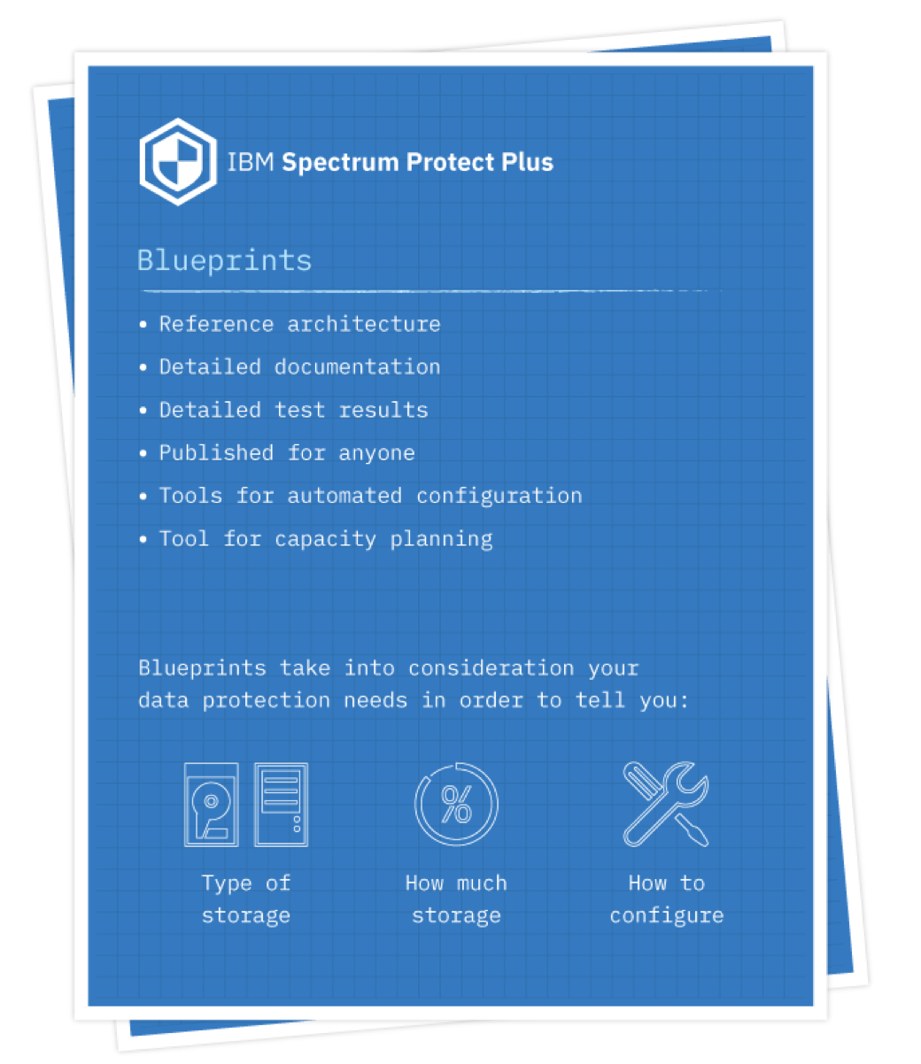

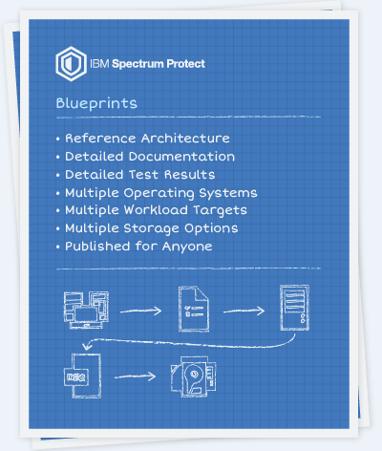










IBM Data Resilience Portfolio
Data Creation
Core Data Resilience
Data Resilience Integration & Testing
Data Resilience Targets
Traditional Apps
Hypervisors
Storage Systems
Scale-out Apps
Containers
IaaS, PaaS, SaaS
Notes:
One fact we know for sure, the way in which data gets created is always evolving. Data is being created by applications on physical systems to virtual machines to born on the cloud containerized applications. All of this data is subject to data resilience and requires protection. IBM is continuing to provide the most comprehensive modern, data protection solution in the market, especially focused on supporting new applications created by new systems such as containers.
IBM’s data resilience portfolio is made up of multiple software solutions that can protect information in multiple ways. The IBM data resilience portfolio, at its core, is made up of Spectrum Protect, Spectrum Protect Plus and Spectrum CDM. In addition, Spectrum Archive can be utilized for clients who require an archive for corporate governance or long-term retention. IBM has also integrated these products with solutions such as Spectrum Discover to provide richer optimization, governance and analysis of your protected data.
All of the data backed up with IBM’s data resilience solutions can be protected with a number of target devices such as disk, tape, virtual tape, software defined storage or cloud backends to provide the greatest amount of flexibility to meet overall recovery and cost objectives.
And while, it may seem like a Hodge podge of products, the reality is, these solutions have been tested in different configurations and we have built specific design blueprints to help meet performance and scale needs as well as deploy the solution efficiently and correctly. For the greatest deployment success, please take advantage of these blueprints.

Slide 11




The Evolution of IBM Data Resilience Portfolio
Virtual Machine
Virtual Machine
App
App
App
App
Bin / Library
Bin / Library
Container
Container
Container
App
App
App
Operating System
Operating System
Bin / Library
Bin / Library
Bin / Library
App
App
App
Hypervisor
Container Runtime
Operating System
Operating System
Operating System
Hardware
Hardware
Hardware
1980
2000
2020
Traditional Deployment
Virtual Deployment
Container Deployment
Notes:
It’s important to highlight, as we did on the left-hand side of the last slide, that data is now created several ways. This slide shows the different Spectrum data resilience solutions that can protect these different environments.
Physical systems require Spectrum Protect in order to protect these environments. In the virtual environments both Spectrum Protect and Spectrum Protect Plus can be used with each having their own benefits depending on the use case. And for container environments, Spectrum Protect Plus is the solution to protect these environments.
No matter the compute platform, IBM can provide a data resilience solution to meet all business SLAs.

Slide 12


Key Considerations for a Data Resilient Infrastructure
Recover from Tape
Offline copies provide a true air-gap
RTO = > Hours
IBM Tape
Recover from Immutable Storage or Cloud
Logical air-gap
Immutable storage
RTO = Hours
Recover Backup from VM or Containers
Instant recovery from file or VM
Application aware
Global catalog of recovery points
RTO = Minutes
Recover Primary Data from Snapshots
Instant recovery from file or VM
Application aware, orchestrated
Global recovery of recovery points
RTO < = Minutes
Notes:
Here are 4 key considerations to ensure a data resilient infrastructure.
We all know that tape provides a true airgap, and most clients today still utilize tape. We are also finding clients that used to use tape and moved away from tape are actually going back to tape. It is the lowest cost for storing data long term and provides a true air-gap capability to provide the highest level of secure data storage.
However, with tape, the RTO will be long. The process of streaming data can take a while and once complete, if the newly recovered data is infected, the process will need to be done all over again. Also, once the data is recovered, the data will need to be tested in an isolated environment to make sure that the data recovered doesn’t contain malware and data in the production environment doesn’t become infected. In this scenario, the RTOs could be hours or even days.
This has us thinking about “where” data is protected. Immutable storage can provide a logical airgap that can help speed up the recovery process. Remember, cyber recovery is about 2 things; time and costs or not having to pay the ransomware. The faster the business is up and running, the lower the downtime, the lower the financial impact. Recovery, either streaming data or snaps from immutable storage can be much faster than tape. This can reduce recover time to only a few hours or so.
Next, we think about the software side of things and how the data is protected. Today’s modern technologies such as Spectrum Protect Plus store the protected copy of data in native format making the recovery near instant. In addition, Protect Plus provides a global catalog to find the data quickly and easy with multiple recovery points that come up as fast as the click of a mouse. This can help reduce recover times to minutes. This data is stored in a vSnap repository, that is not on the production storage, and the vSnap can be located on immutable storage or in the cloud as well.
And finally, by taking advantage of Spectrum CDM, similar to Spectrum Protect Plus, clients can take advantage of a global catalog for snaps that can be recovered in an instant. Unlike Spectrum Protect Plus, snapshots are stored on the array and can be recovered quickly for a very low RTO.

Slide 13
Spectrum Protect
Internal: Spectrum Protect in Seismic: https://bit.ly/3lH9YFg
External: Spectrum Protect Data Sheet: https://ibm.co/2XIl81Y
Scale
Each server scales to 4 PB of client data ~100TB change per day
Consolidate 7 backup media servers to 1
Lowers CapEx / OpEx
Broadest Workload Support
Greatest number of applications and OS support for both physical and virtual systems
Cloud Support
Run in, run on, backup to:
IBM Cloud
Amazon AWS
Microsoft Azure
Google Cloud
S3 object support
Tremendous Cost Savings
Incremental forever
Deduplication
Compression
Multi-backend support (tape, object, etc…)
Notes:
Let's take a look at 3 of the key software components of IBM’s data resilient portfolio.
First is Spectrum Protect. Spectrum Protect has been cited as a “leader” in the Gartner Magic Quadrant for Data Center Backup and Recovery for the last 9 consecutive years.
Spectrum Protect has the longevity in the market that clients want when it comes to a data resilience solution.
Spectrum Protect with its unmatched scale and usability is 2nd to none in the industry when it comes to lowering CapEx and OpEx for data all resilience needs.
The solution has the broadest workload support across operating systems and applications on both physical and virtual systems.
Spectrum Protect supports the 4 major cloud players including IBM Cloud, Amazon AWS, Microsoft Azure and Google Cloud including integration with the S3 protocol that enables clients to store their data on a myriad of platforms that support S3.
And when combined with its storage optimization capabilities such as incremental forever, deduplication and compression, the solution delivers tremendous cost savings.

Slide 14










IBM Spectrum Protect – Intelligent Data Resilience
VMware Hyper-V & client
{
Protect data for databases, mail servers, hypervisors, file servers, and workstations
}
Exchange Domino
What
Protecting what runs your enterprise …
Incremental
Deduplicate
{
Efficient data reduction utilizing snapshots, progressive incremental deduplication, and compression
}
How
Flexibility for today and tomorrow …
Snapshot
Compress
Multi-site availability with active-active replication-based architecture and heterogeneous storage flexibility using disk, tape, or cloud
Where
{
}
Store anywhere: IBM’s, yours, theirs …
Disk to cloud (D2C)
Notes:
Spectrum Protect protects the applications and systems that run the enterprise from databases to email and file servers to hypervisors and a variety of workstations and provides the flexibility and storage efficiency needed to reduce costs and meet or exceed service level agreements.
In addition, data can be stored almost anywhere to better help meet business SLAs, data resilience needs and costs.

Slide 15
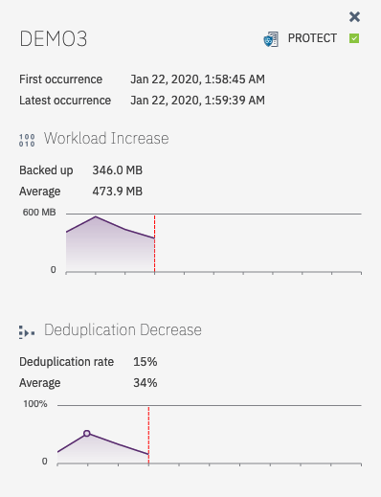
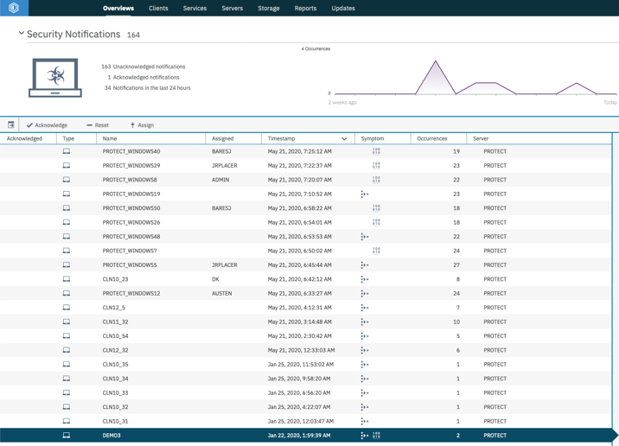
Monitoring Workload Pattern Anomaly Detection
Notes:
Spectrum Protect also has added data resilience capabilities around workload pattern anomaly detection to help detect when cyber-attacks happen.
Should the change rate in your backup ingest or the change rate in your deduplication ratio be altered unexpectedly, Protect sends a warning to the data protection administrator letting them know this has happened.
In some cases, the admin may be aware that the change rate or backup times change, this usually happens when data is added to an environment and needs to be protected and depending on data type, the dedupe ratio will also change. When this happens, the backup admin may know about this and everything is okay, but if ransomware or malware get into the environment and start changing files, then the ingest rate and dedupe rate will change. Again, the backup administrator will be notified and can investigate the issue.

Slide 16
Spectrum Protect Plus
Internal: Spectrum Protect Plus in Seismic: https://bit.ly/36F1ND2
External: Spectrum Protect Plus Data Sheet: https://ibm.co/3btNWjC
Enterprise Proven
Data Protection
VMware / Hyper-V
Containers
Cloud
Data reuse
Simplicity
Simple architecture
Simple to deploy, manage & use
Agentless Filesystem backup for Windows Physical and Virtual
Lower costs
Simple licensing
Lower cost
Not tiered
System/App Support
Databases and applications on physical & virtual systems
Kubernetes
OpenShift
Microsoft 365 – Exchange Online/OneDrive
AWS EC2 EBS Snapshots
Data Reuse
Secure self-service
Data protection / recovery, data resiliency, automated DR
Test/Dev, DevOps, reporting, analytics, etc…
Notes:
The next software product in the data resilience portfolio is Spectrum Protect Plus.
A modern, enterprise proven, solution designed to create copies of revenue producing data in virtual and container environments for a number of data use cases including:
Backup and recovery
DevOps or Test/Dev
Analytics
Reporting or
Automated DR testing
Spectrum Protect Plus supports a number of virtual environments, container environments as well as multiple cloud environments and a broad range of applications, including born on the cloud applications with the greatest simplicity making it easy to deploy, manage and use. Its agentless architecture and secure self-service enable the Spectrum Protect Plus solution to help modernize the overall data protection environment while lowering both CapEx and OpEx.

Slide 17








Spectrum Protect Plus – Data Resilience
Low Deployment Cost Ease of Management
Proactive Backup Catalog
Instant Recovery
Data Access
Broad System Support
Immediate ROI Reduced CapEx/OpEx
Automated Data Protection
Lowest RTO
VMs, Containers & Applications
Automation
Orchestration
Software Defined
Self-service – RBAC
RESTful APIs
Software-defined
Flexible Management
DevOps, Dev-Test
Application Integration
Notes:
Here are a number of key reasons Spectrum Protect Plus is considered a modern data resilience solution:
The solution has low deployment costs and is simple to manage which helps produce an immediate return on your investment.
The solution has broad system support including the VMs, containers, the cloud and applications allowing a common tool to protect an entire environment.
Spectrum Protect Plus has a “proactive backup catalog”. This helps to automate the backing up and tracking of all data copies without having to think about it.
Spectrum Protect Plus provides instant access of its backup data for both operational recovery purposes as well as for data reuse, keeping downtime to a minimum and secure data access to a maximum.
The solution is software defined, providing clients the greatest flexibility providing the ability to leverage investments already made in the resilience infrastructure
Spectrum Protect Plus provides secure roles-based access control enabling IT to provide secure self-service capabilities to departments that need access to the data
Spectrum Protect Plus also provides automation and orchestration that enable not only SLA based protection but the ability to provide templates to recover data where and when needed outside any disaster and when combined with RESTful API’s teams can orchestrate data reuse data needed for applications such as Chef or Puppet

Slide 18



IBM Spectrum Copy Data Management (CDM)
Internal: Spectrum CDM in Seismic: https://bit.ly/32Ut57d
External: Spectrum CDM Data Sheet: https://ibm.co/39wQ36T
Systems
Applications
In-place snapshot copy data management solution
Provides instant data access for multiple reuse use cases
Recovery
Dev/Ops – Test/Dev
Analytics
Reporting
Automated DR
Data resilience
IBM FlashSystem 5000
IBM FlashSystem 5100
IBM FlashSystem 7200
IBM FlashSystem 9200
IBM FlashSystem 9200R
SAN Volume Controller Spectrum Virtualize & Spectrum Virtualize for Public Cloud
VersaStack
EMC VNX and Unity
NetAPP
Pure Storage
Notes:
The third software component in our Data Resilience portfolio is Spectrum CDM.
Spectrum CDM is an “in-place” copy data management solution, meaning clients don’t need to buy an additional appliance to get copy management capabilities. It is a software solution deployed as a VM and supports hardware APIs that can manage the snapshots of multiple, heterogenous systems as well as provide crash consistent copies of applications such as Oracle and SAP HANA to name a few.

Slide 19



IBM Spectrum CDM Provides Complete Copy Automation
Create Copies
Track Copies
Use Copies
Snapshots, Replicas, Clones
Catalog
Map LUNs, Spin Up Systems
Refresh Copies
Transition Copies
Delete Copies
Test
Prod
Automated DR and Dev-Test refresh
Test to Production
Clean Up
Notes:
How does CDM work? Spectrum CDM utilizes hardware APIs to create snapshots, replicas or clones of data and it keeps track of every copy in a catalogue. Spectrum CDM can then use these copies for multiple business purposes. Spectrum CDM can automate the reuse, or recovery of these snapshots and can even refresh or provide fresh copies of this data to users on an ad-hoc or schedule basis. When it is decided that the data that is in use needs to be pushed into production, Spectrum CDM can help you do that quickly and easily and when extraneous copies of data need to be “cleaned up” the Spectrum CDM catalogue can tell you where these copies are and help to automatically clean them up so as not to be utilizing too much storage capacity.

Slide 20




Data Resilience Wheel
Remote
Local
RBAC
Identity: Managing credentials and acquisition of data
LDAP
Code Signing
Multi-factor
(future)
Authority
Administrative: Roles and rights to the management of data copies
Approval
Config
Scanning
RBAC
(future)
GUI
Data-Level: Managing the secure placement and copies of data
Privilege
Replicated
Policy
Multi tenancy
In-flight
Copy
WORM
(future not CDM)
Bit-Level: Managing the integrity of the data stored and in-flight
Bit-rot
WORM
At rest
Encryption
Container: Managing the authenticity and use of the container application
Notes:
Each product in our data resilience portfolio has special capabilities that help with an added level of resilience. We have categorized these into 3 types of security:
Identity security
Administrative security
Data security
And for Spectrum Protect we have Bit-level Security and for Protect Plus we have container level security.
As you can see, there are some features that will be available later in the year, these are the ones marked “future” but most of these capabilities are available today from each of the products.

Slide 21







Types of Air-gap
Logical
Physical
Object Storage
Provides patented SecureSlice encryption and SEC 17a-4 compliant WORM immutable storage (WORM = write once, read many media protects data from being over-written with malware*)
Immutable Storage
Provides WORM immutable filesets. (“immutable” or “append-only” functions) When these filesets, files cannot be changed, renamed or deleted.*
Cloud
Backing up data to the cloud can enable you to put data on a separate network not allowing malware to affect this data.
TAPE
Tape is the ONLY physical air-gap available. It can be removed from the tape drive and therefore is not on the network for malware to infect.
OR Spectrum ESS
* true as of today
* true as of today
Notes:
We have mentioned “airgap” a few times now, but I think it’s important to delineate between types of airgap.
Quite frequently we hear the term “logical airgap”. What this is referring to is locking data down in such a way that it can’t be tampered with. The forms of logical airgap we talk about here, as of this moment, haven’t been penetrated. However, as I always say to clients, the hackers will figure out how to get at this data if it is connected in any way to any network, the question is, do you want to be the first to have to report a breach when they figure it out?
Logical air-gap solutions are things like Object Storage which cannot be over written but can be erased. Object Storage with WORM (write once, read many) provides an additional level of lock down not allowing deletion. You can find this capability in IBM’s Cloud Object Storage solution. You can also find WORM capability in our Spectrum Scale software solution or ESS solution which is an appliance built with Spectrum scale software. And lastly, you can, in a sense “hide” data off main corporate networks by creating a copy of it to a cloud provider. This data is not impenetrable but, it can act as a line of defense if hackers find data on prem but not a copy of the data that is off site on a separate network.
There is the physical airgap and as of right now, there is ONLY one form of physical airgap that removes the media the data was written to and pulls it off any network so it cannot be hacked that that is tape. And IBM is the world leader in tape solution. Keep in mind, the tape needs to be removed from the library to be truly “airgapped”

Slide 22




Data Resilience Capabilities in the Cloud
Capability | Cloud Provider
Can be hosted in the cloud as the primary backup target
Can be hosted in the cloud as a replication target
Can back up to cloud object storage
Can store data to cloud object storage for long term data retention
Can protect workloads running in the cloud
Can protect VMware running in the cloud
Can protect SaaS Applications / Microsoft 365 data
Can create and manage cloud native VM-level snapshots
Can reuse data in the cloud (backup can be on-prem or in the cloud)
Available in the cloud marketplace
1
1. Supported with 3rd party offering
More on IBM Data Resilience for all clouds in Seismic: https://bit.ly/38wQwa6
Notes:
When it comes to data resilience, the cloud plays two important roles.
First, data that is created in the cloud needs to be resilient. Cloud providers will tell you that the primary storage where data is stored is quite resilient, it uses geo dispersal to make sure data isn’t lost. However, in order to be able to recover data in the event that it is needed between deletions of data, it must be protected.
Additionally, as we called out earlier, the cloud can be used as a “logical airgap” when needed.
Here we show where and how Spectrum Protect and Spectrum Protect Plus can utilize the cloud.
(And should you want more information on other capabilities these two products have with the different cloud providers, there is a link here to Seismic that is for IBMers and IBM Business Partners only)

Slide 23
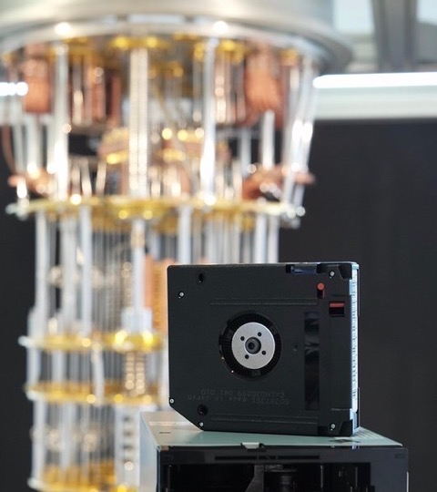
The Quantum Advantage*
IBM TS1160 tape drive uses both Kyber and Dilithium in combination with symmetric AES-256 encryption to enable the world’s first quantum computing-safe tape drive.
The new IBM quantum computing-safe tape drive prototype is based on a state-of-the-art IBM TS1160 tape drive.
* Statement of direction – currently in prototype
Notes:
When it comes to a cyber attach, maleware can lie dormant in the envionment for over 200 days before it is found. Having multiple protection points can help save a company and this is where tape can play a key role. Snapshots can help speed time to recovery. But should the attack have infected data long ago, there may not be a snapshot of data from multipe months ago, going back to tape could be the only clean copy of the data.
IBM’s thought leadership when it comes to security is second to none. IBM is even enhancing its tape encryption to make it virtually inpenatrable. IBM is utilizing Quntum Computing to apply encryption to its tapes. And while this is not available today, it is in prototype and has been talked about in the press as a real-world example of how IBM is leveraging its intelectual capital to helps its cleints create safer, better protected environments.
And, just like most of our technology, once implemented in the field and in practice in our tapes, this capabilitiy mover further into the rest of our storage portfolio.

Slide 24
CRAT Cyber Resilience Assessment Tool
Value
IBM Funded
Low resource investment
Identify resiliency gaps quickly
Workshop Includes
Two-hour workshop
Probes 100s of different controls across 23 categories
Client Outcomes
Discovery of in-place solution
Identify blind spots
Recommendations for improvement
Customized strategy
Deliverables
Detailed assessment report
Executive presentation
Roadmap of recommendations
Project Kickoff
Engagement
Design
Implementation
CRAT
Client Exploratory
Session
Cyber Resilience Maturity Workshop
SME Analysis
Final Report, Presentation & Roadmap
Prioritize & implement suggested improvements across Storage & Resiliency enterprise
CIRSA
Identify participants & customize agenda
Typically 2 hours
Typically 1 hour
1-12+ Months depending on output
1-2 Weeks
Notes:
As a part of IBM’s overall data resilience program, we have developed tools that enable our clients to identify if their environment is able to withstand a cyber incident. One of these tools is our CRAT or Cyber Resilience Assessment Tool.
The tool is an IBM funded tool and doesn’t take a lot of resources to execute and it allows clients to identify gaps in their environment quickly. Clients can soon find this tool on the IBM website, however if you are struggling to find it, please reach out to your technical sales representative or myself and we can provide the tool to you.
The tool is a excel spreadsheeted and can be filled out by the client on their own or IBM can set up a workshop with the client for a couple hours that probes approximately 100 different controls in your environment across 23 different categories.
The tool helps clients understand what’s in place today, identify blind spots, make recommendations for improving the overall resilience of the environment and build out a strategy for implementing things to fortify the environment with.
Once complete a detailed report with an executive level presentation is created as well as a roadmap of recommendations that will help bring the environment up to a more data resilient level.
In some cases, clients may want to engage IBM. A workshop typically takes two hours and IBM would spend another few hours reviewing the answers and putting together a final report, presentation and roadmap that would be delivered over the course of about an hour.
From there, a client would decide which recommendation they wanted to take advantage of and implement in the environment.

Slide 25

Cyber Incident Response Made Simple with Lab Services expertise
Advise
Configure
Review
Enterprise Data Protection
Cyber Resiliency Storage Assessment
Implementation Services
Post Deployment Health checks
High-throughput Air Gap
WORM immutable storage
Safeguarded Copy
Transparent Cloud Tiering supporting hybrid multi-cloud
Educate on Cyber Resiliency trends and best practices
Explore current capabilities for protection, detection, and recovery
Recommend solutions and project roadmap
Cyber Incident Response workshop
Configure and integrate recommendations
Skills Transfer and Document of Implementation
Assist with recovery planning/testing and Run Book creation (optional)
Ongoing Review for Code Currency
Best Practice Configuration Guidance
New Feature Deployment
Assist with recovery retesting and Run Book review (optional)
Contact us Now @ ibmsls@us.ibm.com
Notes:
In addition, IBM has Cyber Incident Response Services Assessment that is a paid engagement from our lab services team that goes to a deeper level than the CRAT. It is important to point out that IBM is the largest security company in the world. And because of this, we have the breadth and depth of expertise around data resilience that is second to none.
Our Lab Services team has developed the Cyber Incident Response Assessment to help understand where there may be gaps in the environment when it comes to responding to cyber threats.
This offering has 3 phases to it.
The Advice phase where we will:
Educate on Cyber Resiliency trends and best practices
Explore current capabilities for protection, detection, and recovery
And recommend solutions as well as a project roadmap for implementation
The Implementation phase will:
Provide a Cyber Incident Response workshop
Help to configure and integrate our recommendations
Provide skills transfer and document the implementation
And assist with recovery planning / testing and Run Book creation
And finally, and perhaps most important is provide a Post Deployment Health Check. (Remember as they say, an untested plan isn’t a plan.)
We can provide an ongoing review of your environment for code currency
Best Practice Configuration Guidance
New Feature Deployment
And assist with recovery retesting and Run Book review
Should you want to take advantage of this offering, please reach out to IBM or Business Partner sales rep, and they can help get the process started. OR please use the email: ibmsls@us.ibm.com and our lab services team will respond and help get the process started.

Slide 26
World Class Customer Service
Instant access to help when an incident takes place
Relentless efforts to solve data resilience issues
Getting the client up and running is the primary objective
Notes:
IBM has been in the business of providing data resilience to client’s data for decades. Our support organization has seen a lot of situations and help clients through them all. They spend tireless hours with clients to help them recover their data and hence their business. Their primary objective is to get the client’s business back up and running.

Slide 27

Lessons Learned Best Practices
Clients we have had the most success in recovering in the shortest amount of time have all done the following:
Protected their active directory or LDAP server
Utilized tape to provide a true air-gap of their data
Ensured there was an isolated network to test restores
Protected the protected copies of data
Backed up the backups / multiple copies of backup data
Use the 3-2-1 methodology in the protection architecture
3 Copies of data
2 locations
1 copy off-line
Practiced the recovery processes multiple times per year
Took advantage of WORM storage of some sort
Notes:
Over the past 24 months our Systems support team has delt with a number of clients who have been attacked by ransomware or malware, we are probably dealing with one client per week these days when it comes to data resilience.
To that end we have learned a great deal and there are some best practices that clients can take advantage of to help them be more prepared for a cyber-attack. These are:
Protected your active directory or LDAP server
Utilized tape to provide a true airgap of data
Ensure there is an isolated network to test restores in
Protect backup copies of data
Backup the backups / multiple copies of backup data
Use the 3-2-1 data protection methodology
3 Copies of data
2 locations
1 copy off-line
Practiced the recovery processes multiple times per year
And take advantage of some form of WORM storage
These will help ensure success at getting the business up and running as quickly as possible.

Slide 28

How Much Should Data Resilience Cost?
Part of this conversation take into consideration your budget?
The budget would be a part of analysis done to determine the value of your data.
Key things to keep in mind:
Data value
RTO – recovery SLAs
Level of security (air-gap)
Today’s infrastructure
Retention needs
Notes:
Often times we are asked “how much should data resilience cost?” Like most things in IT, the answer is, “it depends”. The first step in answering this question starts at the beginning of this presentation where we discussed classifying data. Next try to identify if all the tools that are needed to create a data resilient environment are available or if additional capabilities need to be purchased.
Thru the review this process, align the SLA needs of the business and the overall value of the data to the tools that are going to be used to protect the data. For example, data that has a very low RTO may need to be stored on disk versus tape, and in order to safeguard that data on disk the disk may need to be immutable storage. This would be a more costly disk class than one that doesn’t provide immutability. So, this process needs to take everything into account, and only then will you know the costs in order to properly protect the data and meet the needs of the business.
A key question to ask is what is, “What is the value of the data in the environment to the business”? Businesses should plan on spending at least that much to protect it.

Slide 29
RFE - Request for Enhancements… https://ibm.co/2YmPs3Q
Tell IBM what you need
https://ibm.co/3aQnPmu
Vote on or Track RFEs
https://ibm.co/2VOs6Ct
Become an influencer
Access to features before they’re released
Evaluate how new features meet your needs
Influence designs and product direction
Interact directly with product teams
Collaborate with IBM experts and other users
Become an IBM reference customer and share your success
Join our Sponsor User and Beta programs and make your voice heard.
Enroll today:
ibm.biz/sponsors
Notes:
Clients like to provide IBM feedback on our existing data resilience solutions or have made requests and would like to see what stage the RFE or request for enhancements is at in its process of becoming a capability in the product.
The links provided here provide the ability to either create a new Request for an Enhancement, track one that has already been requested, or browse the ones that have been submitted and voting on them in order to increase their priority.
In addition, to become an influencer of the product, or become a sponsor user, select the influencer link and this entitles the client to:
Have access to features before they’re released
Evaluate how new features meet your needs
Influence designs and product direction
Interact directly with product teams
Collaborate with IBM experts and other users
Become an IBM reference customer and share your success
This provides uses with a stake in the success of the product portfolio, and hence their businesses success.

Slide 30

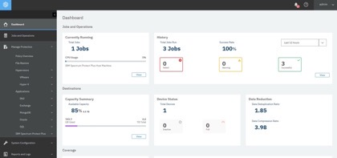
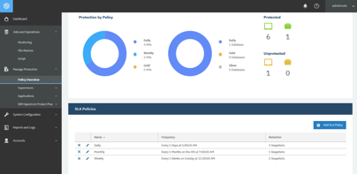
IBM Data Resilience Advantage Summary
Costs
CapEx/OpEx
Simple and easy to deploy, manage and use
Extreme scale
Consolidate 7 backup servers to 1
4000 backup systems per FTE
Storage efficiency
Performance
Protect 100TB per day per server
Multi threading
Instant recovery (2.5 TB restore < 3 min)
Self-service, fast data access
Multicloud
Broadest number of cloud support
Support building XaaS
Use as compute, target and reuse
Support for OpenShift and K8s
Support for IBM Cloud Paks
Resilience
Workload patter anomaly detection
End-to-end encryption
Flexible retention
Disk, tape, air-gap, immutable storage, WORM, cloud
RBAC
Agility
Software defined
Data mobility
Data Reuse
Dev/Ops, analytics, reporting, automated DR
Metadata management
Proactive data management
Notes:
In summary, IBM has a very clear understanding as to what data resilience means and the requirements needed for businesses to have a data resilient environment.
IBM’s data resilience solutions help to ensure the resilience of data from the moment it is created to keeping it safe and secure and useable throughout its data lifecycle. It does that while ensuring businesses can:
Keep costs in check, both capex and opex.
Ensure the best overall performance of recovery in the event data is compromised and need to be restored
Can put data in multiple locations, including the cloud, for reuse use cases and safe keeping
Keep an eye on what is happening within the protected data repositories and be on the lookout for ransomware or malware
And can enable businesses the ability to reuse data in these protected repositories for multiple business purposes, enabling competitive advantage in ways other vendors can’t.
IBM’s data resilience solutions help to ensure businesses are securely protected and can recover, or are resilient, in the event something should happen to the data within the environment.

Slide 31
Resources
First place to check – Seismic for MDP https://bit.ly/34n57CV
Spectrum Protect – https://bit.ly/3lH9YFg
Spectrum Protect Plus – https://bit.ly/36F1ND2
Spectrum Copy Data Management – https://bit.ly/32Ut57d
Cloud Object Storage – https://bit.ly/3lAeCnC
Spectrum Scale – https://bit.ly/3lHulBo
IBM Tape – https://bit.ly/3gdv9Nk
Cyber Resilience Assessment Template - https://bit.ly/36DxEFs
Contacts:
Steve Kenniston – Market Development Executive
steve.Kenniston@ibm.com
IBM Internal and Business Partners Only
Notes:
For more information regarding data resilience and the solutions available in the Systems portfolio, please see these references and as always you can reach out to the folks listed here for help and more information.
(Please keep in mind that the links on this slide can only be accessed by IBMers and Business Partners)

Slide 32
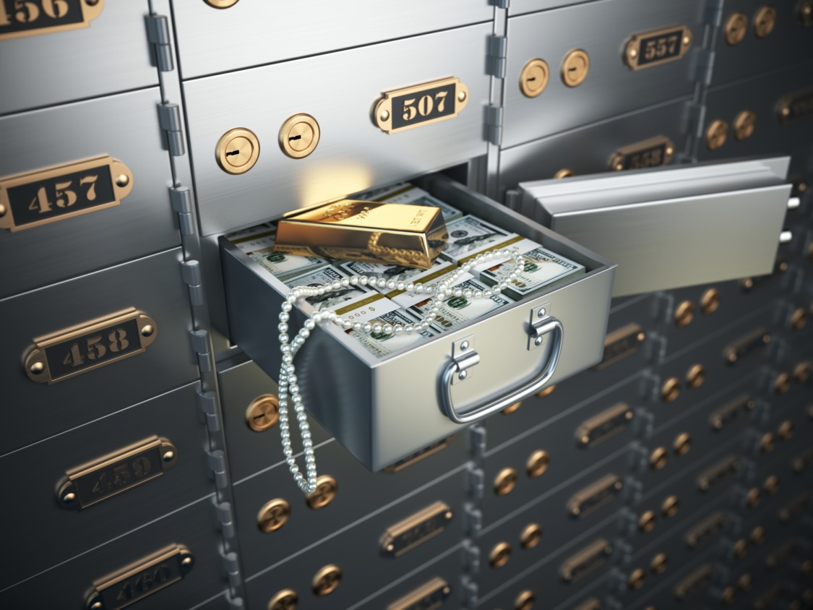
Thank You!
Is your data resilient enough?
Steve Kenniston
Market Development Executive
Spectrum Storage Software
IBM Systems
steve.kenniston@ibm.com
@skenniston
linkedin/in/skenniston
Notes:
Data Resilience is on the top of everyone’s mind today and is one of the most critical things for clients to wrap their arms around.
I hope this was useful and I’d like to thank you for your time and attention.
Again, any questions, my contact detail are listed here, please do not hesitate to reach out.

